Slide 1
Emphasize your ideas in the data visualization plot

Slide 2
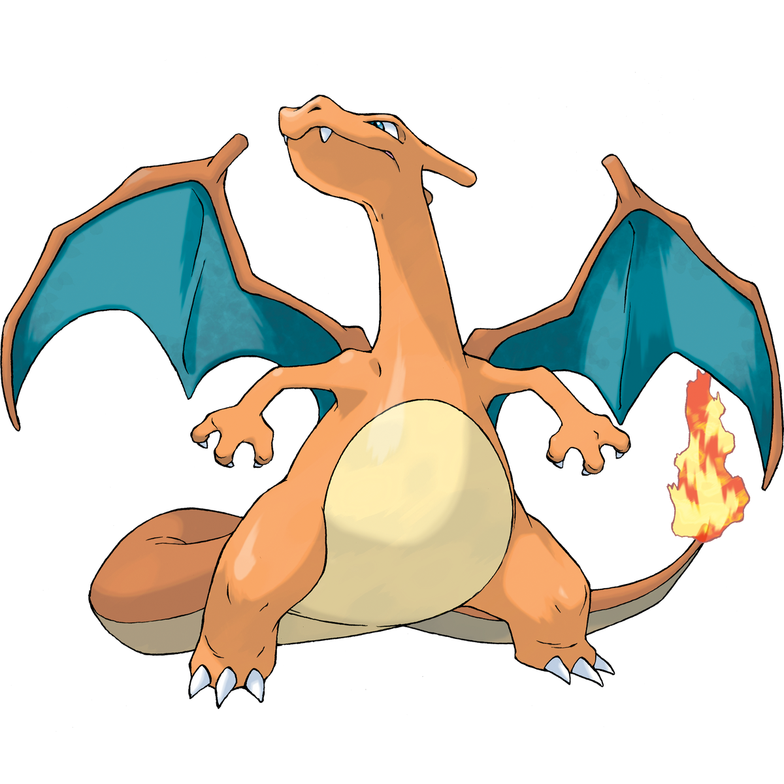
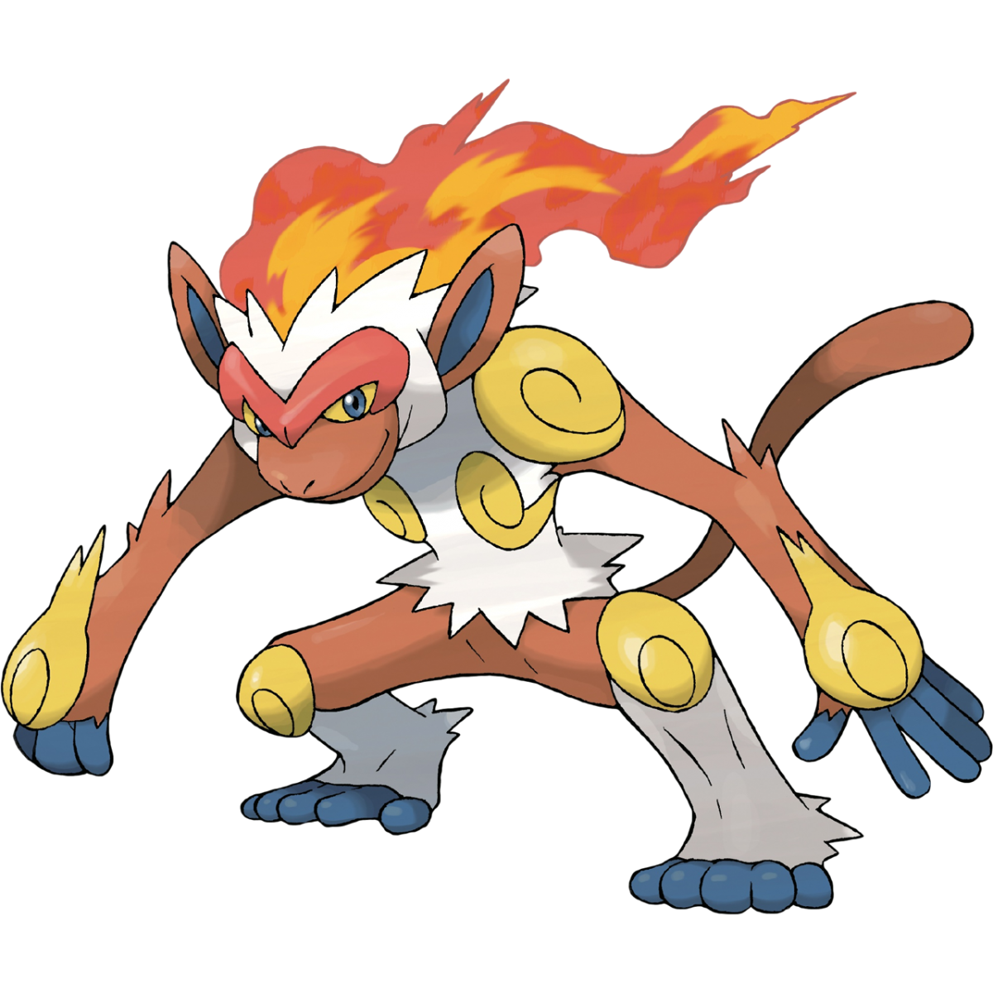
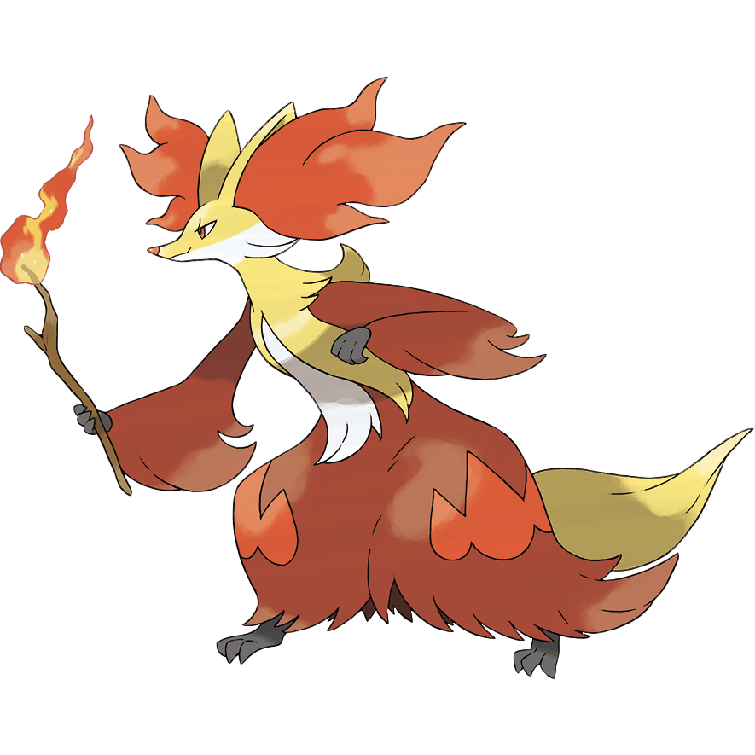

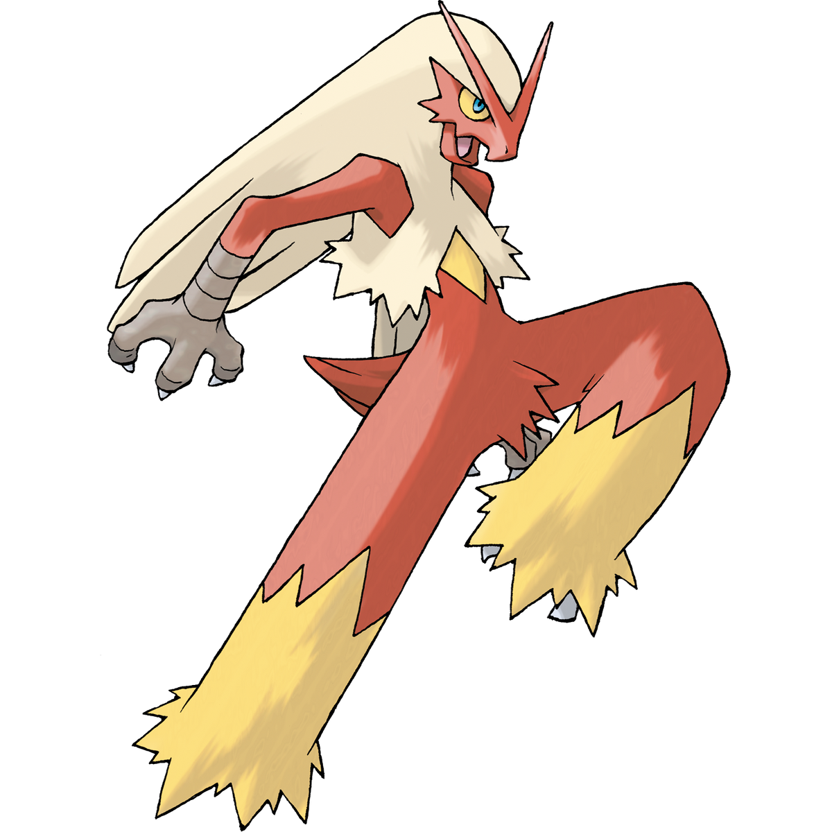


Introduction
In this project, as a pokemon enthusiast, I want to compare the species strength of these seven different types pokemon in attack, defense, special attack, special defense, speed, respectively.
The concept of species strength is similar to the talent of the pokemon in particular aspect. The higher it is, the more outstanding growth in that aspect will be.
Charizard | Typhlosion | Blaziken | Infernape | Emboar | Delphox | Incineroar

Slide 3
Introduction
I will present the data with bar chart. All data is shown as the table at the below.
I will show how do I decorate my bar plot in this project, rather than visualize big dataset.
pokemon | attack | defense | sp_attack | sp_defense | speed
charizard | 84 | 78 | 109 | 85 | 100
Typhlosion | 84 | 78 | 109 | 85 | 100
Blaziken | 120 | 70 | 110 | 70 | 80
Infernape | 104 | 71 | 104 | 71 | 108
Emboar | 123 | 65 | 100 | 65 | 65
Delphox | 69 | 72 | 114 | 100 | 104
Incineroar | 115 | 90 | 80 | 90 | 60
Let’s use data in attack column to get start !

Slide 4
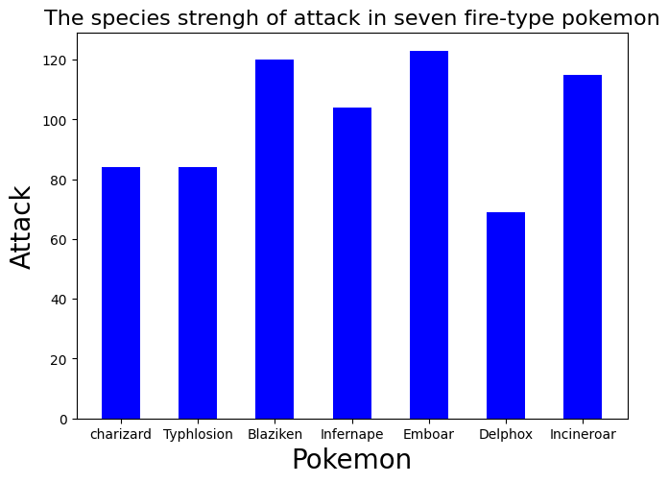
Basic bar plot
The common bar chart plot is as shown at the right hand side.
It is still comprehensible that we could learn Emboar, Blaziken and Incineroar are top three at the attack growth.
The axis label is small and the tiny different among top three makes it difficult to distinguish.
Moreover, the entire figure is unattractive. If I could add some pictures on it, it will be more eye-catching to audience.

Slide 5
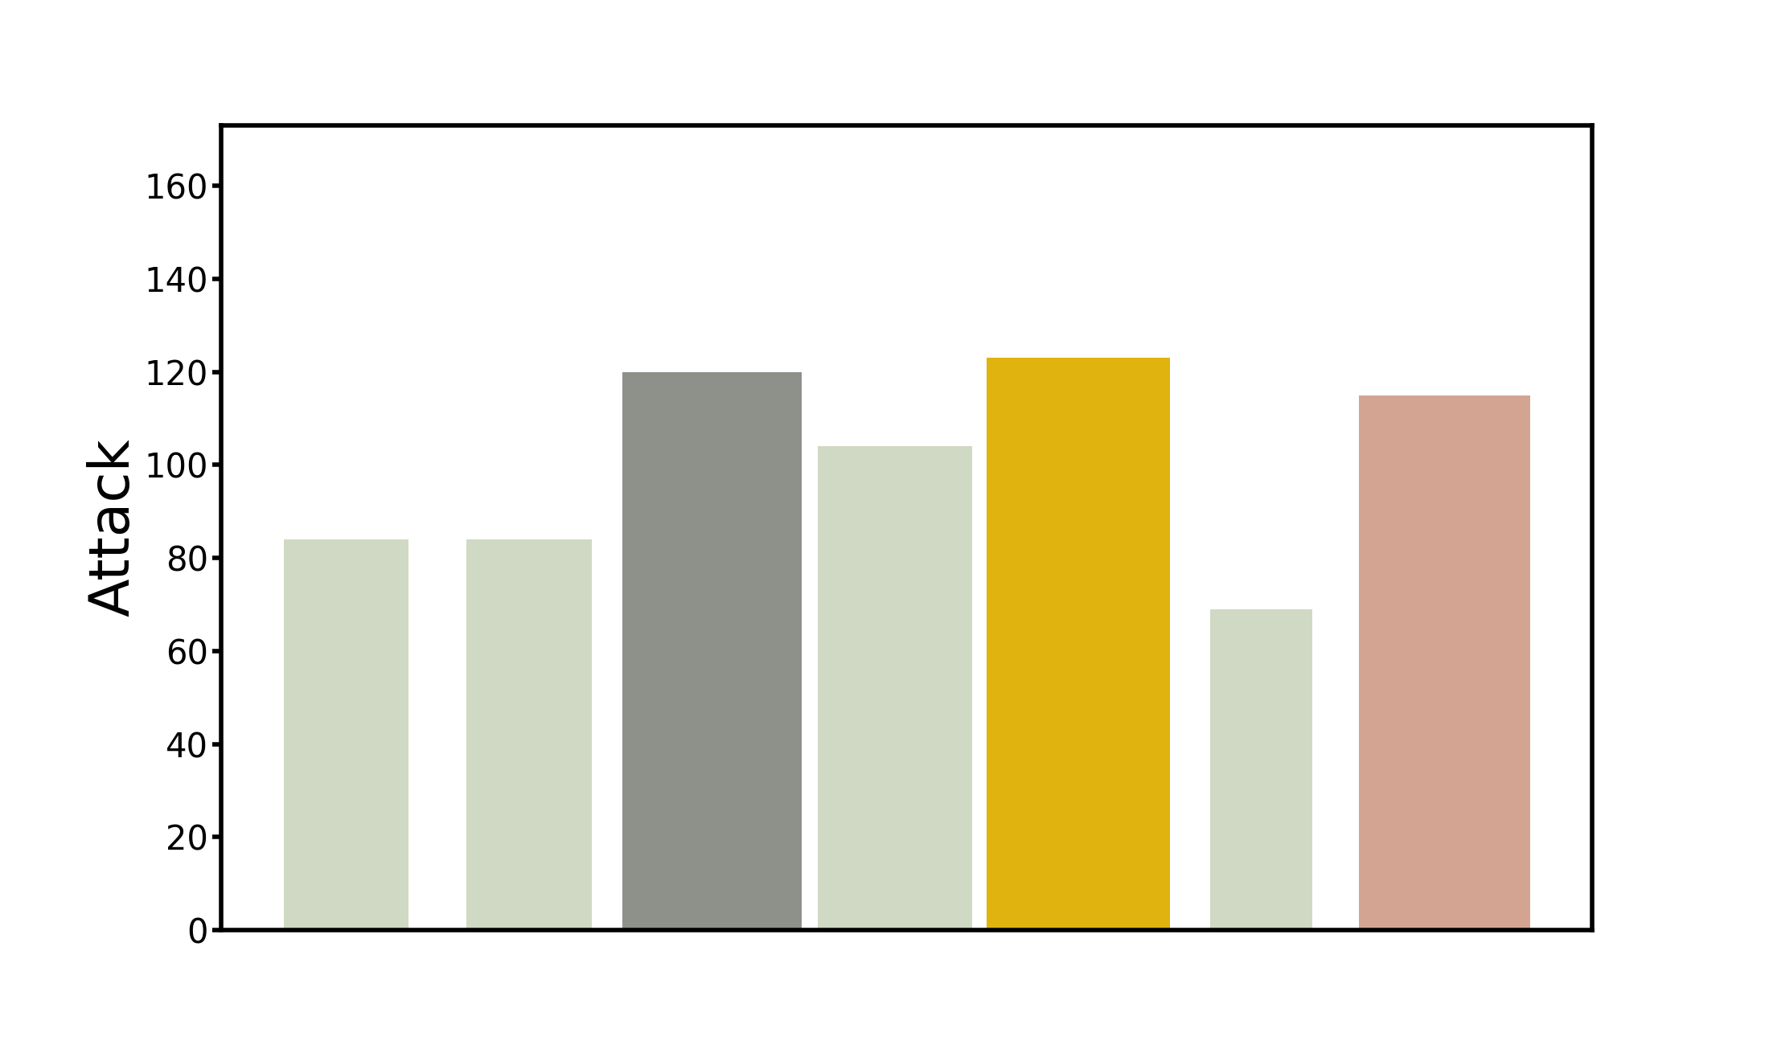
Decoration flow
Among top three, I properly increase the width of bar to emphasize them.
Adopt the medal illustration and use gold, silver, bronze color to label the top three, respectively.

Slide 6
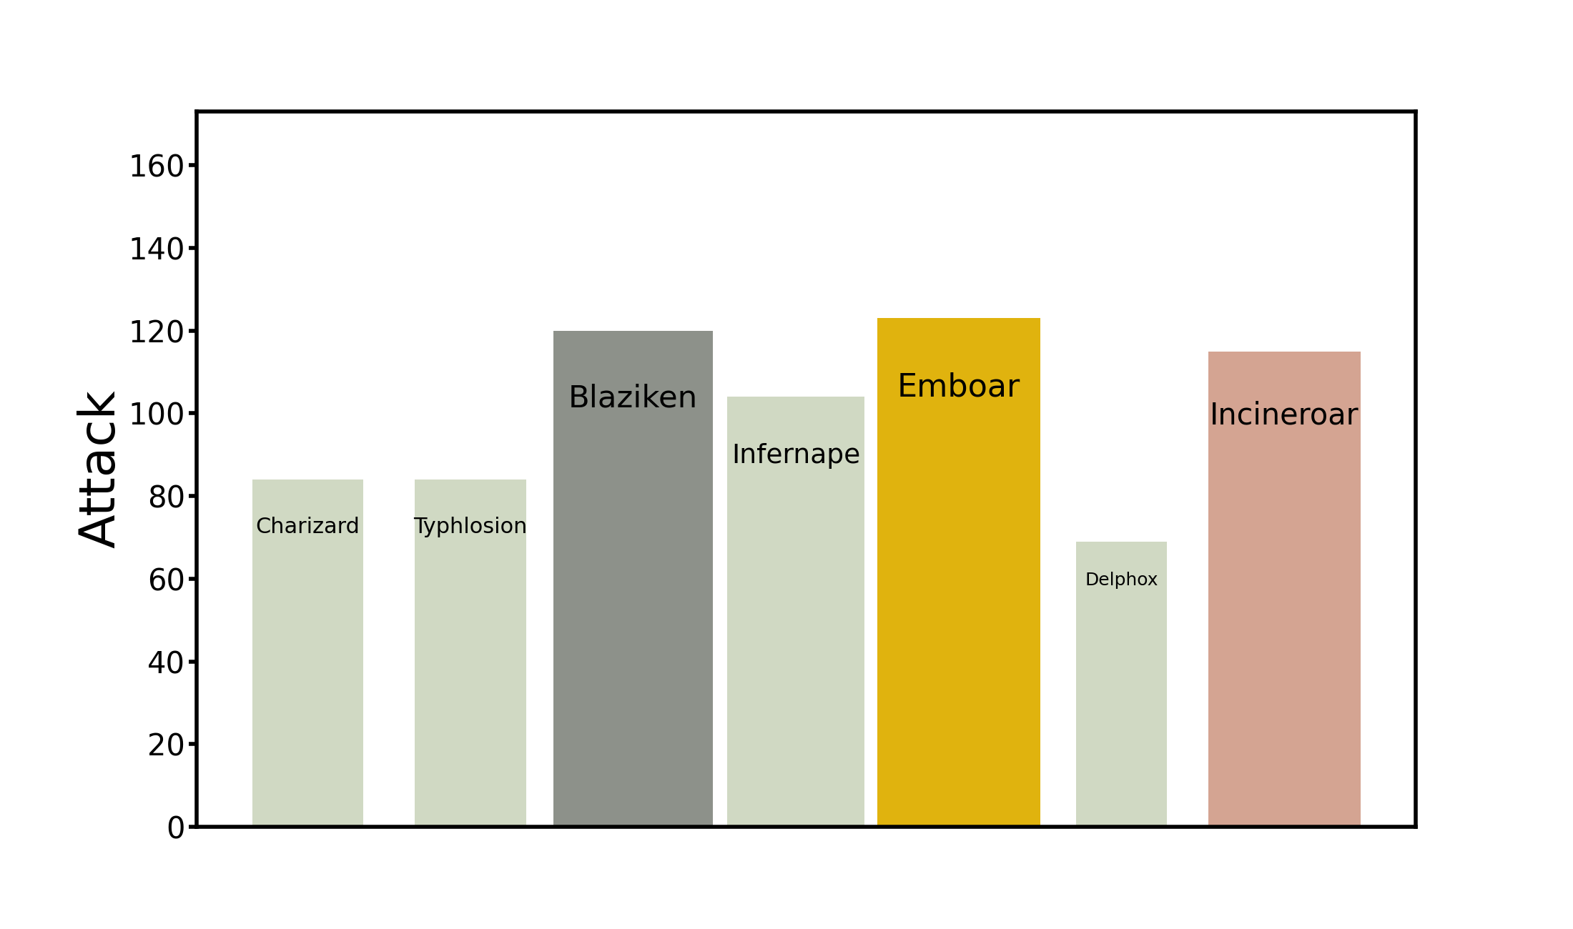
Decoration flow
Shift the name of pokemon from the x-axis to the top of bar. It will be more easier to read

Slide 7
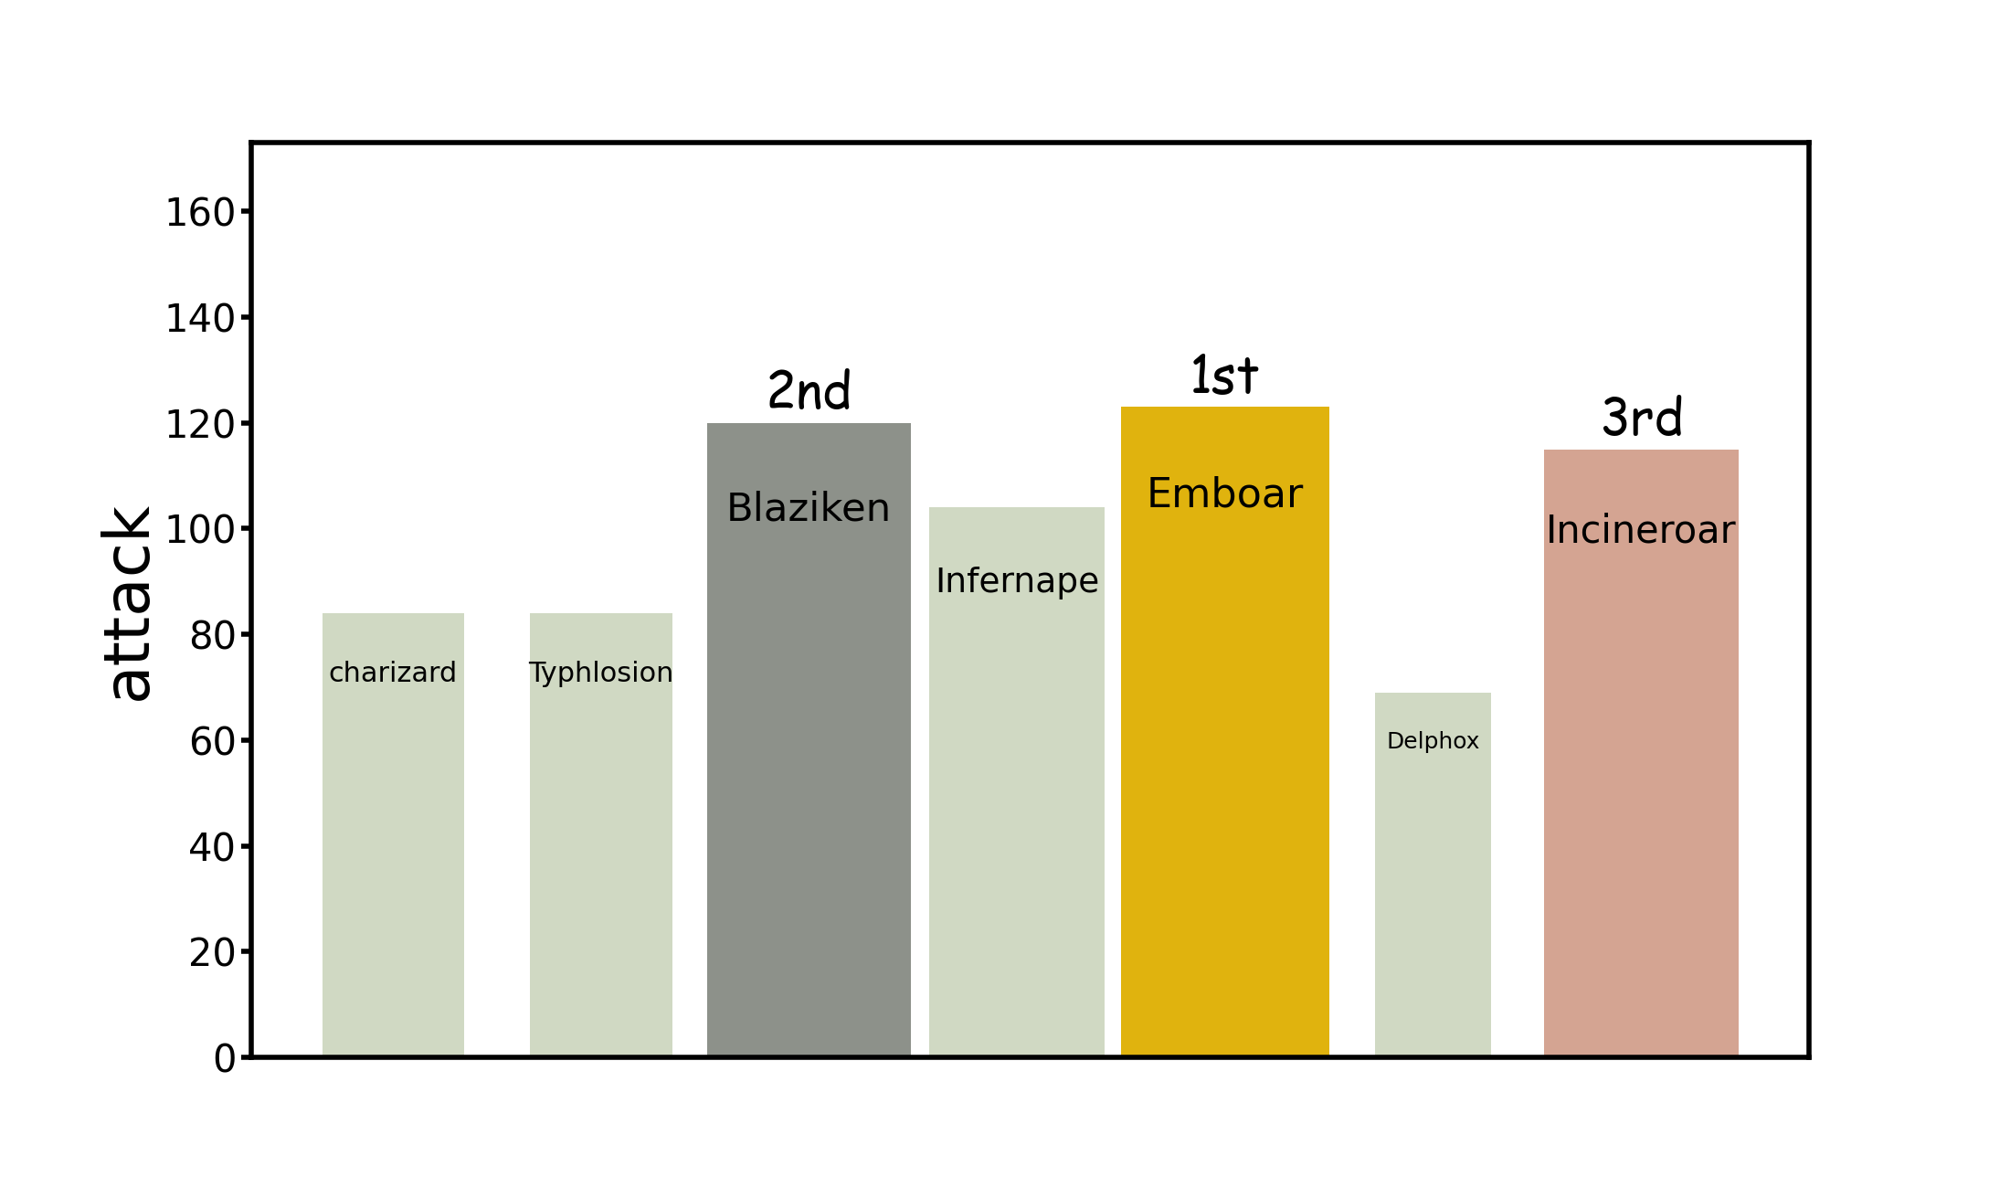
Decoration flow
Mark top three with 1st, 2nd and 3rd.

Slide 8
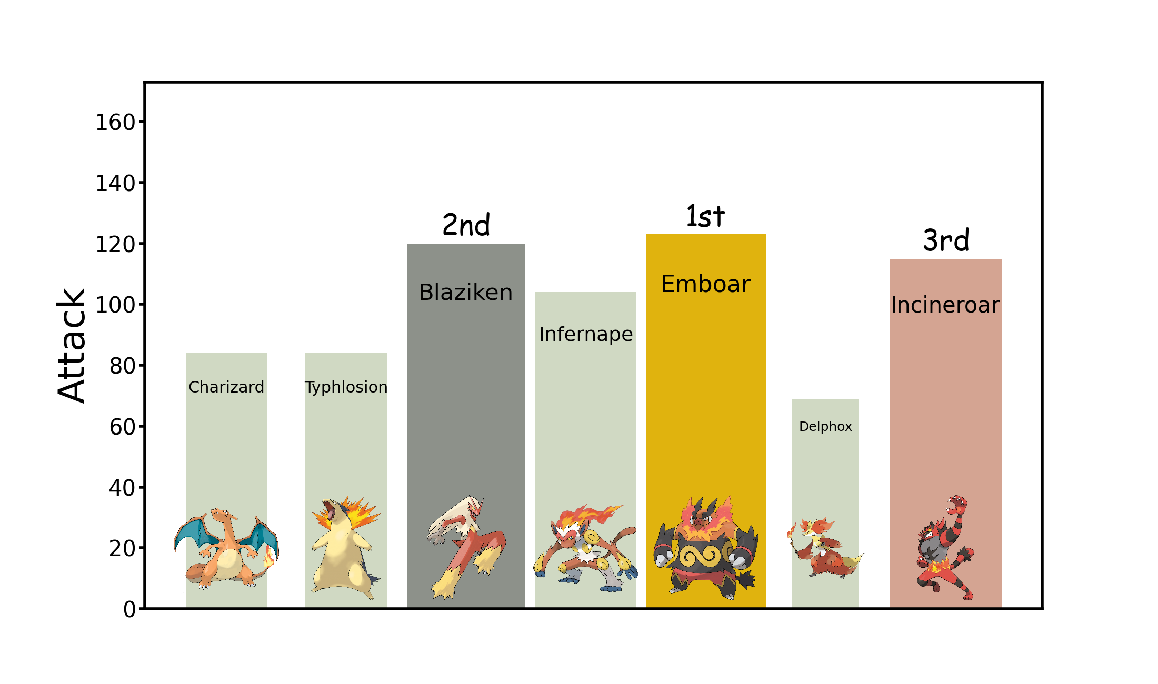
Decoration flow
Finally, Add each pokemon photo to the corresponding position to decorate this plot
This kind of chart will be more attractive to the audience and can be applied to business reports.
According to the flow mentioned before, plot defense, special attack, special defense and speed, respectively.

Slide 9

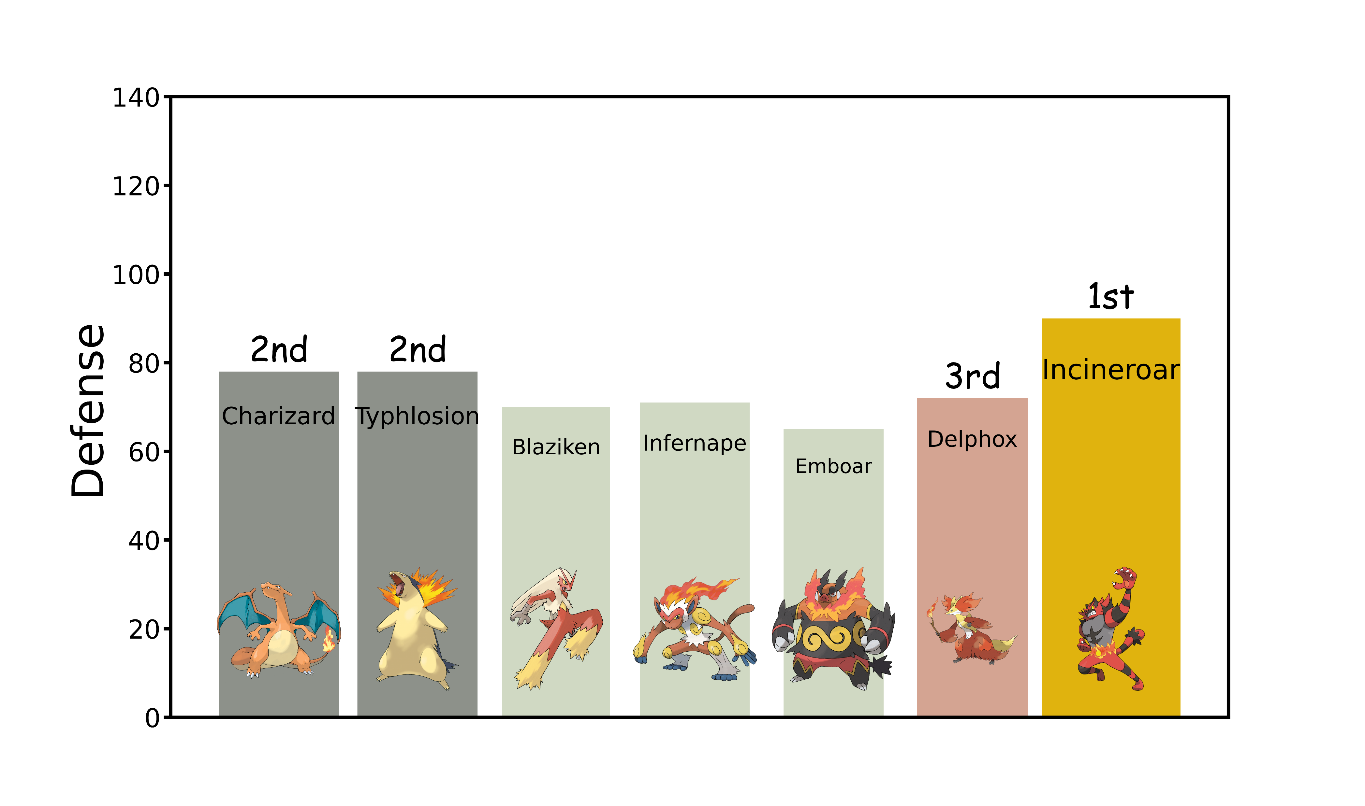
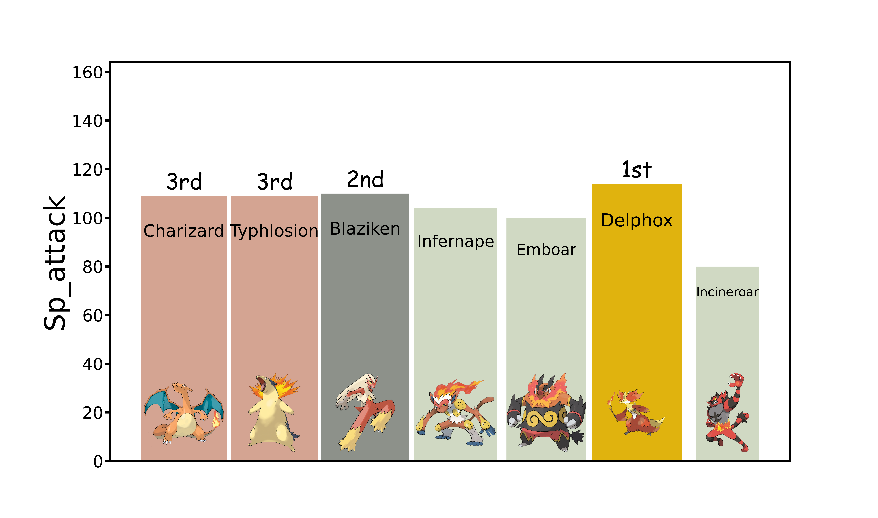
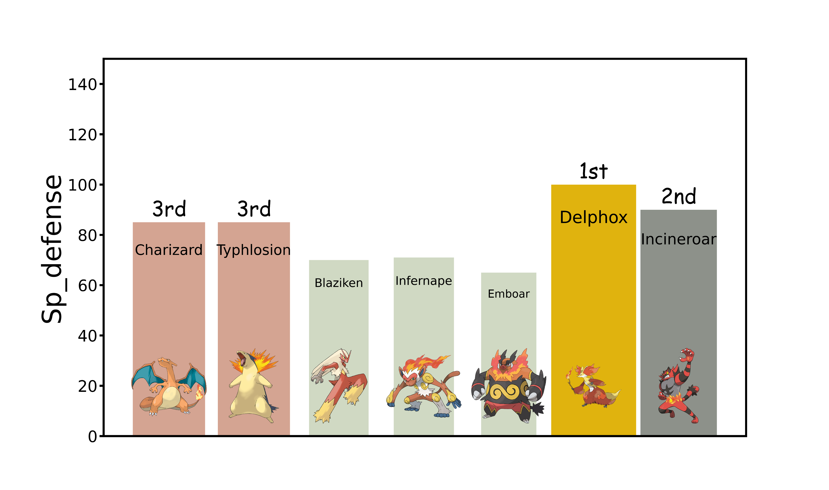
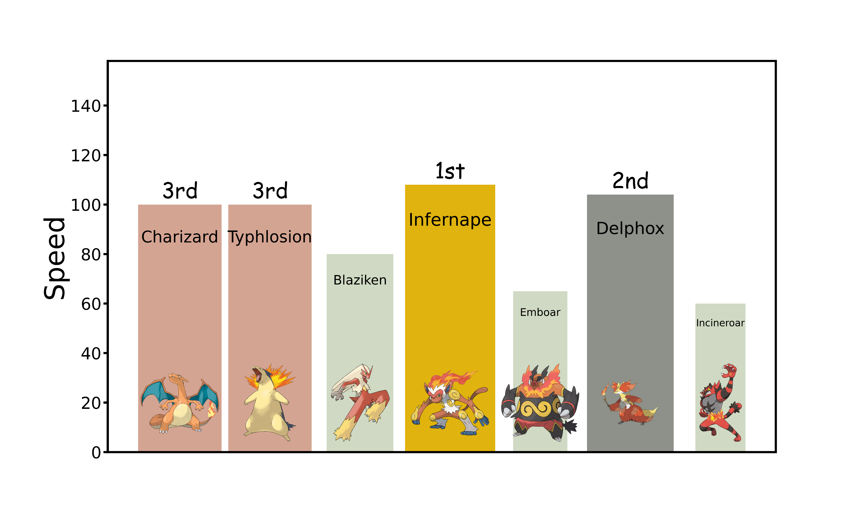
Result

